Slide 1

Principal Component Analysis

Slide 2

Contents
Covariance
Eigen Values & Eigen Vectors
Dimensionality Reduction
Principal Component Analysis
Mathematical Modelling – PCA Algorithm 1
PCA Algorithm 1 – Example
Mathematical Modelling - PCA Algorithm II
Applications of PCA
Notes:
Description here

Slide 3
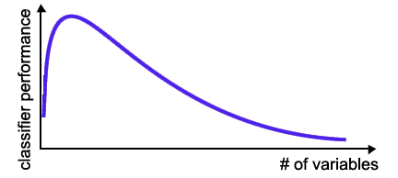
Curse Of Dimensionality
The required number of samples (to achieve the same accuracy) grows exponentionally with the number of variables!
In practice: number of training examples is fixed!
=> the classifier’s performance usually will degrade for a large number of features!
Principal Component Analysis

Slide 4
Covariance
Variance and Covariance are a measure of the “spread” of a set of points around their center of mass (mean)
Variance – measure of the deviation from the mean for points in one dimension e.g. heights
Covariance as a measure of how much each of the dimensions vary from the mean with respect to each other.
Covariance is measured between 2 dimensions to see if there is a relationship between the 2 dimensions e.g. number of hours studied & marks obtained.
The covariance between one dimension and itself is the variance
Principal Component Analysis

Slide 5

Covariance
$$cov\left(x,y\right)=\frac{1}{n−1}\sum_{i=1}^{n}{(x−\overline{x})(y−\overline{y})}$$
So, if you had a 3-dimensional data set (x,y,z), then you could measure the covariance between the x and y dimensions, the y and z dimensions, and the x and z dimensions.
Measuring the covariance between x and x , or y and y , or z and z would give you the variance of the x , y and z dimensions respectively.
Principal Component Analysis

Slide 6
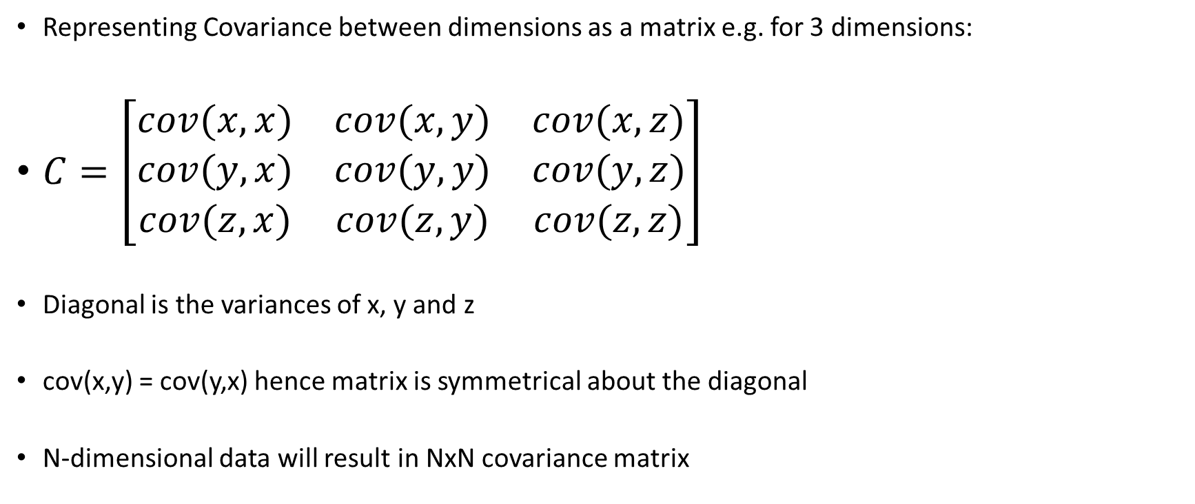
Covariance
Representing Covariance between dimensions as a matrix e.g. for 3 dimensions:
$C=\left[\begin{matrix}cov(x,x) & cov(x,y) & cov(x,z) \\ cov(y,x) & cov(y,y) & cov(y,z) \\ cov(z,x) & cov(z,y) & cov(z,z)\end{matrix}\right]$
Diagonal is the variances of x, y and z
cov(x,y) = cov(y,x) hence matrix is symmetrical about the diagonal
N-dimensional data will result in NxN covariance matrix
Principal Component Analysis

Slide 7
Eigen Values and Eigen Vectors
In linear algebra, an eigenvector or characteristic vector of a linear transformation is a non-zero vector whose direction does not change when that linear transformation is applied to it.
More formally, if T is a linear transformation from a vector space V over a field F into itself, then v is an eigenvector of T.
T(v)= λ V
where λ is a scalar in the field F, known as the eigenvalue, characteristic value, or characteristic root associated with the eigenvector v.
Principal Component Analysis

Slide 8
Eigen Vectors
Principal Component Analysis

Slide 9
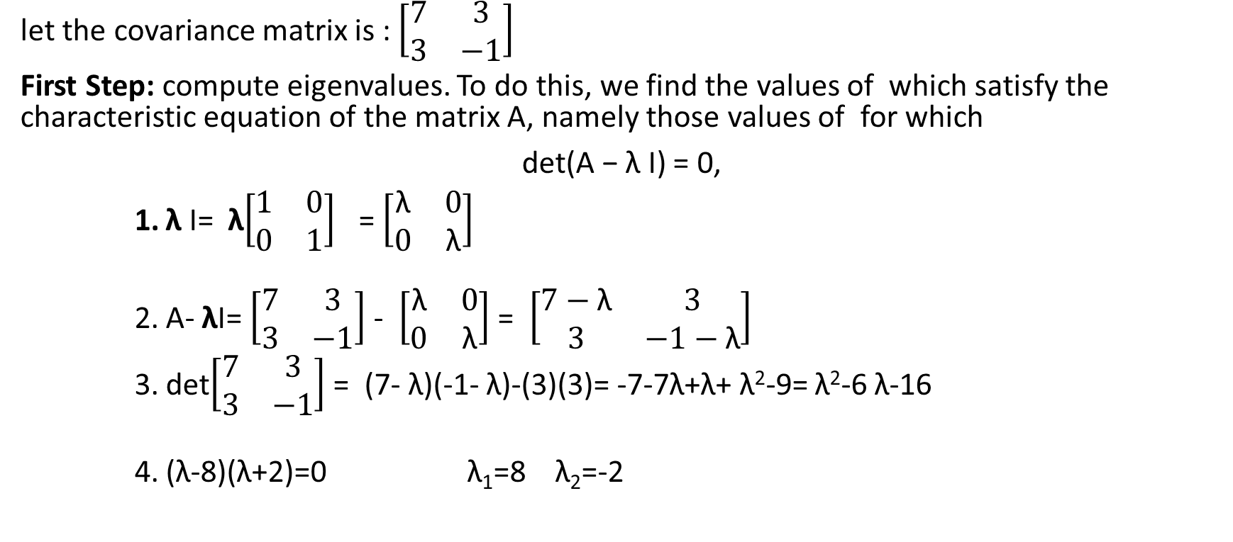
Example: how to find eigenvalues and eigenvectors
let the covariance matrix is : $\left[\begin{matrix}7 & 3 \\ 3 & −1\end{matrix}\right]$
First Step: compute eigenvalues. To do this, we find the values of which satisfy the characteristic equation of the matrix A, namely those values of for which
det(A − λ I) = 0,
λ I= λ$\left[\begin{matrix}1 & 0 \\ 0 & 1\end{matrix}\right]$ = $\left[\begin{matrix}\text{λ} & 0 \\ 0 & \text{λ}\end{matrix}\right]$
A- λI= $\left[\begin{matrix}7 & 3 \\ 3 & −1\end{matrix}\right]$ - $\left[\begin{matrix}\text{λ} & 0 \\ 0 & \text{λ}\end{matrix}\right]$ = $\left[\begin{matrix}7−\text{λ} & 3 \\ 3 & −1−\text{λ}\end{matrix}\right]$
det$\left[\begin{matrix}7 & 3 \\ 3 & −1\end{matrix}\right]$ = (7- $\text{λ}$)(-1- $\text{λ}$)-(3)(3)= -7-7$\text{λ}\text{+}\text{λ}$+ $\text{λ}$²-9= $\text{λ}$²-6 $\text{λ}$-16
($\text{λ}$-8)($\text{λ}$+2)=0 λ₁=8 $\text{λ}$₂=-2
Principal Component Analysis
Let this equation equal to zero and solve it
EigenValues

Slide 10
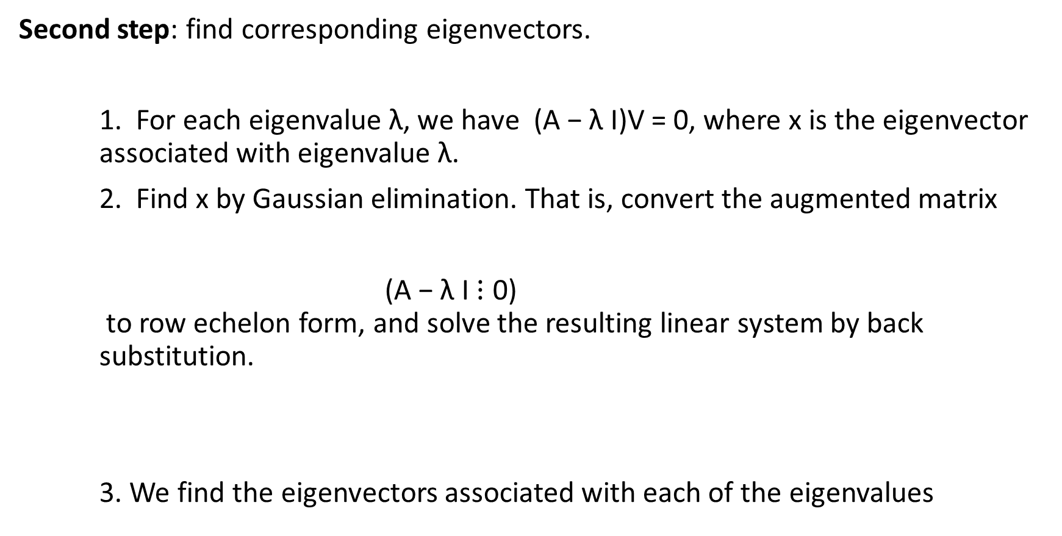
Second step: find corresponding eigenvectors.
For each eigenvalue λ, we have (A − λ I)V = 0, where x is the eigenvector associated with eigenvalue λ.
Find x by Gaussian elimination. That is, convert the augmented matrix
(A − λ I $⋮$ 0) to row echelon form, and solve the resulting linear system by back substitution.
3. We find the eigenvectors associated with each of the eigenvalues
Principal Component Analysis

Slide 11

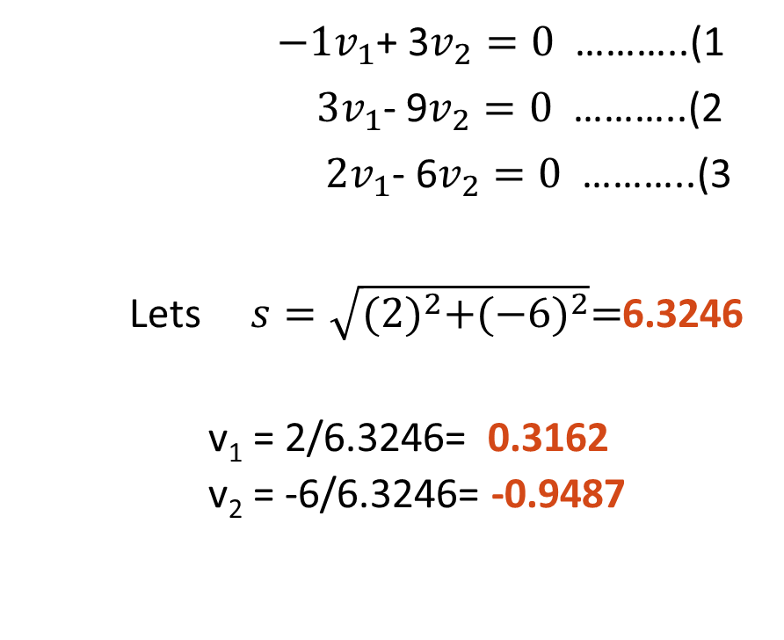
When λ1=8 A- λI=$\left[\begin{matrix}7−\text{8} & 3 \\ 3 & −1−\text{8}\end{matrix}\right]$ = $\left[\begin{matrix}−1 & 3 \\ 3 & −9\end{matrix}\right]$
(A − λ I)V = 0 $\left[\begin{matrix}−1 & 3 \\ 3 & −9\end{matrix}⋮\begin{matrix}v_{1} \\ v_{2}\end{matrix}\right]$=0
${\left({−1×v}_{1}\right)+\left(3×v_{2}\right)=0}_{ }$ ${\left({3×v}_{1}\right)+\left(−9×v_{2}\right)=0}_{ }$
${−1v}_{1}$+ 3$v_{2}=0$ ………..(1
${3v}_{1}$- 9$v_{2}=0$ ………..(2
${ 2v}_{1}$- 6$v_{2}=0$ ………..(3
Lets $s=\sqrt{{(2)}^{2}+{(−6)}^{2}}=$6.3246
v₁ = 2/6.3246= 0.3162
v₂ = -6/6.3246= -0.9487
Principal Component Analysis

Slide 12

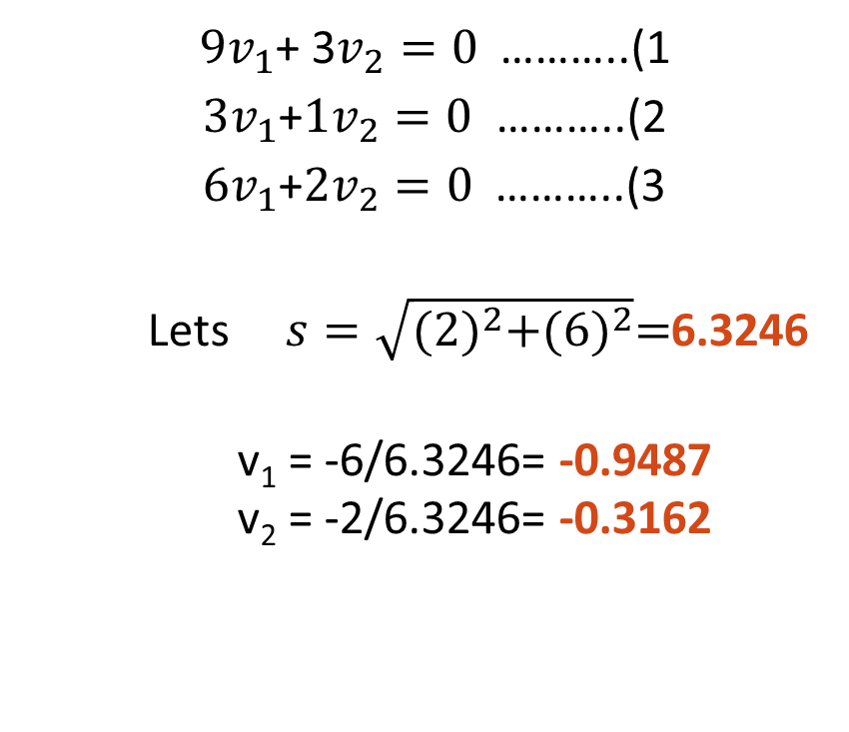
When λ1=-2 A- λI=$\left[\begin{matrix}7+2 & 3 \\ 3 & −1+2\end{matrix}\right]$ = $\left[\begin{matrix}9 & 3 \\ 3 & 1\end{matrix}\right]$
(A − λ I)V = 0 $\left[\begin{matrix}9 & 3 \\ 3 & 1\end{matrix}⋮\begin{matrix}v_{1} \\ v_{2}\end{matrix}\right]$=0
${\left({9×v}_{1}\right)+\left(3×v_{2}\right)=0}_{ }$ ${\left({3×v}_{1}\right)+\left(1×v_{2}\right)=0}_{ }$
${9v}_{1}$+ 3$v_{2}=0$ ………..(1
${ 3v}_{1}$+$1v_{2}=0$ ………..(2
${ 6v}_{1}$+$2v_{2}=0$ ………..(3
Lets $s=\sqrt{{(2)}^{2}+{(6)}^{2}}=$6.3246
v₁ = -6/6.3246= -0.9487
v₂ = -2/6.3246= -0.3162
Principal Component Analysis

Slide 13
Algebraic Interpretation – 1D
Given m points in a n dimensional space, for large n, how does one project on to a 1 dimensional space?
Principal Component Analysis

Slide 14
Algebraic Interpretation – 1D
Given m points in a n dimensional space, for large n, how does one project on to a 1 dimensional space?
Choose a line that fits the data so the points are spread out well along the line
Principal Component Analysis

Slide 15
Algebraic Interpretation – 1D
Formally, minimize sum of squares of distances to the line.
Why sum of squares? Because it allows fast minimization, assuming the line passes through 0
Principal Component Analysis

Slide 16
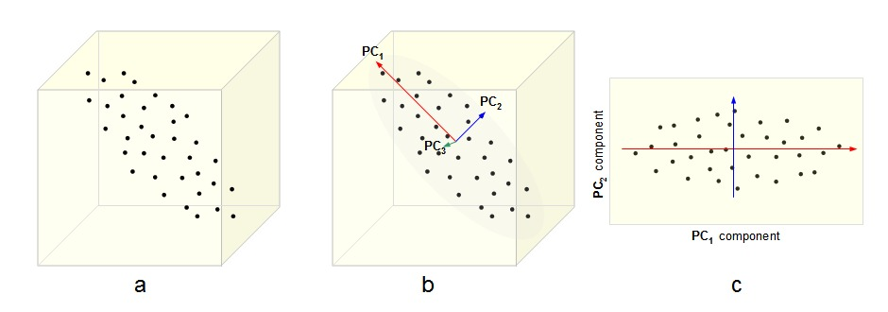
3D to 2D Reduction
Principal Component Analysis

Slide 17
3D to 2D Reduction
Principal Component Analysis

Slide 18
Data Reduction
summarization of data with many (p) variables by a smaller set of (k) derived (synthetic, composite) variables.
p
k
Principal Component Analysis
A
X
n
n

Slide 19
Principal Component Analysis
Principal component analysis (PCA) is a way to reduce data dimensionality
PCA projects high dimensional data to a lower dimension
PCA projects the data in the least square sense– it captures big (principal) variability in the data and ignores small variability
Principal Component Analysis

Slide 20
PCA algorithm I (sample covariance matrix)
Given data {x₁, …, x_{m}}, compute covariance matrix Σ
PCA basis vectors = the eigenvectors of Σ
Larger eigenvalue ⇒ more important eigenvectors
where
Principal Component Analysis

Slide 21
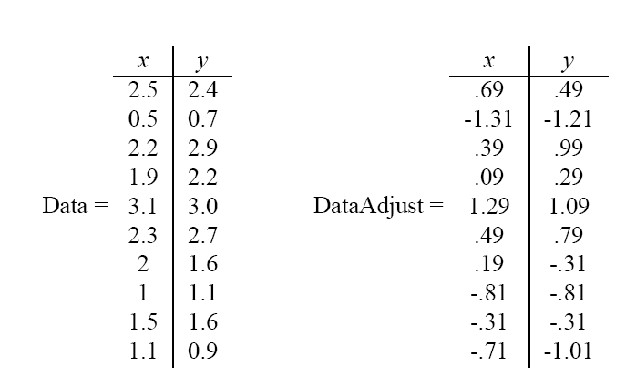
PCA Example
Given original data set S = {x¹, ..., x^{k}}, produce new set by subtracting the mean of attribute A_{i} from each x_{i}.
Principal Component Analysis
Mean: 1.81 1.91
Mean: 0 0

Slide 22
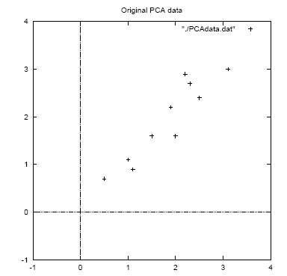
PCA Example
Principal Component Analysis

Slide 23
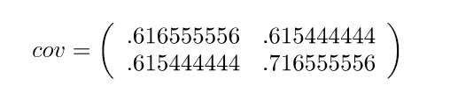
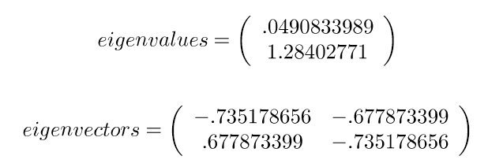
PCA Example
Calculate the covariance matrix:
3. Calculate the (unit) eigenvectors and eigenvalues of the covariance matrix:
x y
x
y
Principal Component Analysis

Slide 24
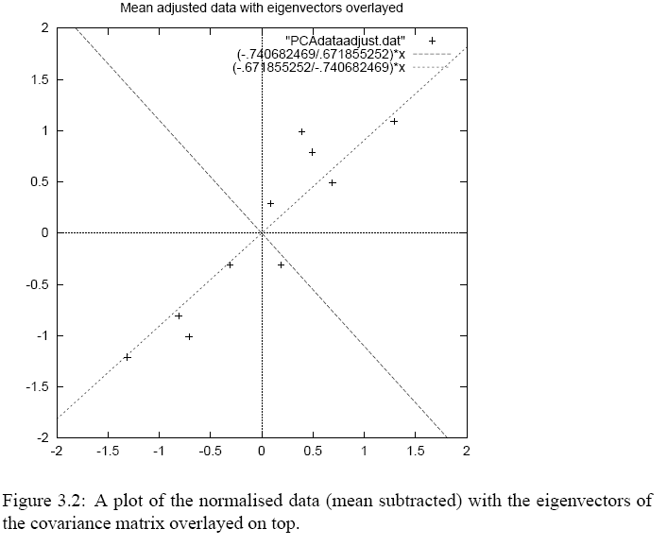
PCA Example
Eigenvector with largest eigenvalue traces linear pattern in data
Principal Component Analysis
By finding the eigenvalues and eigenvectors of the covariance matrix, we find that the eigenvectors with the largest eigenvalues correspond to the dimensions that have the strongest correlation in the dataset.
This is the principal component.

Slide 25
PCA Example
Order eigenvectors by eigenvalue, highest to lowest.
In general, you get n components. To reduce dimensionality to p, ignore n−p components at the bottom of the list.
Principal Component Analysis

Slide 26
PCA Example
Construct new feature vector.
Feature vector = (v₁, v₂, ...v_{p})
Principal Component Analysis

Slide 27
PCA Example
Derive the new data set.
TransformedData = RowFeatureVector × RowDataAdjust
This gives original data in terms of chosen components (eigenvectors)—that is, along these axes.
Principal Component Analysis

Slide 28
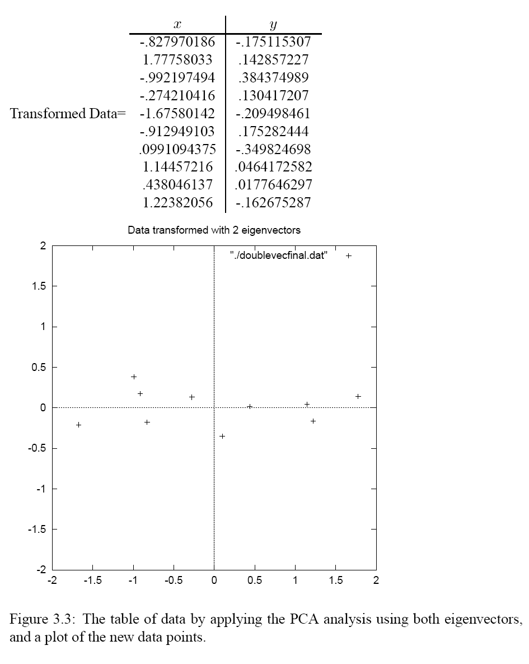
PCA Example
Principal Component Analysis

Slide 29
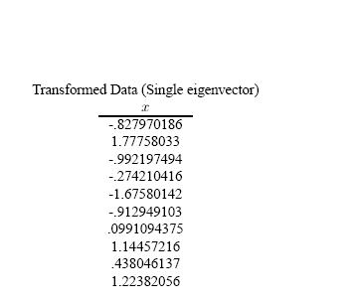
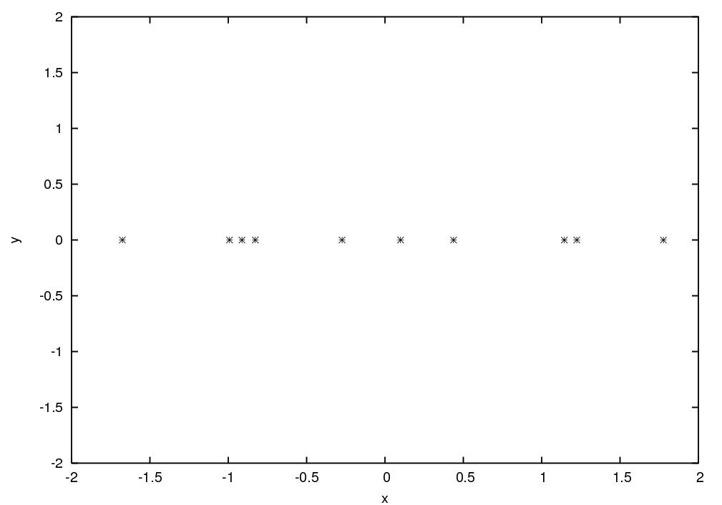
PCA Example - Result
Principal Component Analysis

Slide 30
Reconstructing the original data
We did:
TransformedData = RowFeatureVector × RowDataAdjust
so we can do
RowDataAdjust = RowFeatureVector ⁻¹ × TransformedData
= RowFeatureVector ^{T} × TransformedData
and
RowDataOriginal = RowDataAdjust + OriginalMean
Principal Component Analysis

Slide 31
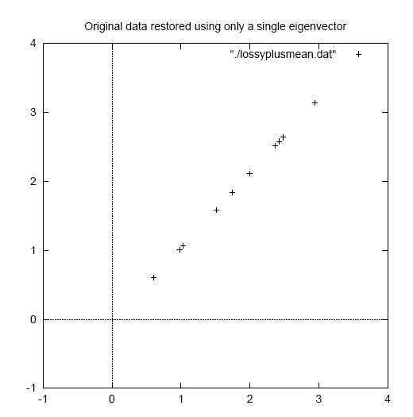
Reconstructed Data
Principal Component Analysis

Slide 32
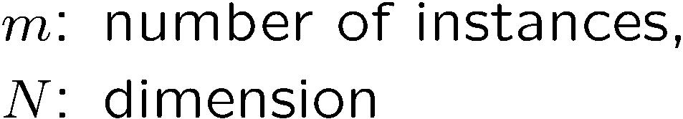
PCA algorithm II (SVD of the data matrix)
Singular Value Decomposition of the centered data matrix X.
X_{features × samples} = USV^{T}
Principal Component Analysis
X
=
U
S
V^{T}
sig.
significant
noise
noise
significant
noise
samples

Slide 33
PCA algorithm II
Columns of U
the principal vectors, { u⁽¹⁾, …, u^{(k)} }
orthogonal and has unit norm – so U^{T}U = I
Can reconstruct the data using linear combinations of { u⁽¹⁾, …, u^{(k)} }
Matrix S
Diagonal
Shows importance of each eigenvector
Columns of V^{T}
The coefficients for reconstructing the samples
Principal Component Analysis

Slide 34
PCA algorithm II
Ureduce= U(:,1:k);
Z=Ureduce*X
Z is the final matrix with reduced dimension.
Principal Component Analysis

Slide 35
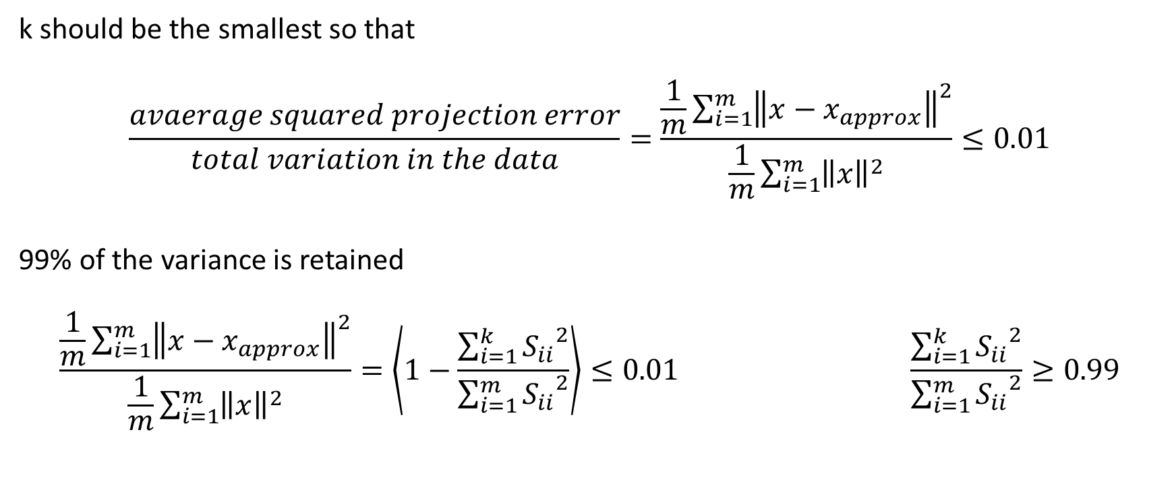
How to choose the value of k(no. of principal components)?
k should be the smallest so that
$$\frac{avaerage squared projection error}{total variation in the data}=\frac{\frac{1}{m}\sum_{i=1}^{m}{{\left\|x−x_{approx}\right\|}^{2}}}{\frac{1}{m}\sum_{i=1}^{m}{{\left\|x\right\|}^{2}}}≤0.01$$
99% of the variance is retained
$$\frac{\frac{1}{m}\sum_{i=1}^{m}{{\left\|x−x_{approx}\right\|}^{2}}}{\frac{1}{m}\sum_{i=1}^{m}{{\left\|x\right\|}^{2}}}=\left\langle 1−\frac{\sum_{i=1}^{k}{{S_{ii}}^{2}}}{\sum_{i=1}^{m}{{S_{ii}}^{2}}}\right\rangle ≤0.01 \frac{\sum_{i=1}^{k}{{S_{ii}}^{2}}}{\sum_{i=1}^{m}{{S_{ii}}^{2}}}≥0.99$$
Principal Component Analysis

Slide 36
Data Visualization
Data Compression - Reduce memory/space needed to store data
Applications of PCA
Principal Component Analysis
Data Compression - Speedup your learning algorithm
Dimensionality reduction

Slide 37
PCA – Python Implementation using sklearn
import numpy as np
from sklearn.decomposition import PCA
import matplotlib.pyplot as plt
np.random.seed(42)
# dataset
n_samples = 100
experience = np.random.normal(size=n_samples)
salary = 1500 + experience + np.random.normal(size=n_samples, scale=.5)
X = np.column_stack([experience, salary])
# PCA with scikit-learn
pca = PCA(n_components=2)
pca.fit(X)
print(pca.explained_variance_ratio_)
Principal Component Analysis

Slide 38
PCA – Python Implementation using sklearn
pca.fit(X)
print(pca.explained_variance_ratio_)
PC = pca.transform(X)
plt.subplot(121)
plt.scatter(X[:, 0], X[:, 1])
plt.xlabel("x1")
plt.ylabel("x2")
plt.subplot(122)
plt.scatter(PC[:, 0], PC[:, 1])
plt.xlabel("PC1 (var=%.2f)" % pca.explained_variance_ratio_[0])
plt.ylabel("PC2 (var=%.2f)" % pca.explained_variance_ratio_[1])
plt.axis('equal’)
plt.tight_layout()
Principal Component Analysis

Slide 39
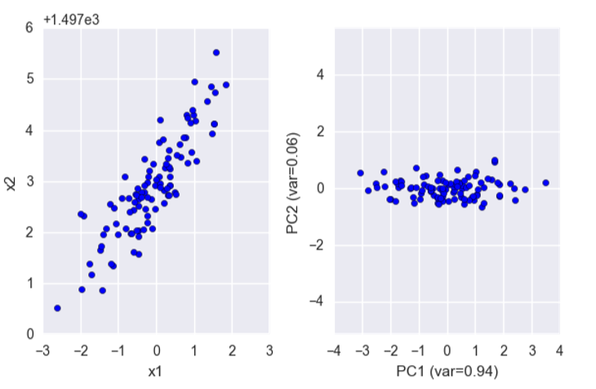
Result
Principal Component Analysis

Slide 40
Exercise
Apply your Basic PCA on the iris dataset
The data set is available at: https://raw.github.com/neurospin/pystatsml/master/data/iris.csv
Describe the data set. Should the dataset been standardized?
Describe the structure of correlations among variables.
Compute a PCA with the maximum number of components.
Compute the cumulative explained variance ratio. Determine the number of components K by your computed values.
Print the K principal components directions and correlations of the K principal components with the original variables.
Plot the samples projected into the K ﬁrst PCs.
Principal Component Analysis

Slide 41
Happy Learning!
Principal Component Analysis
Stay Tuned for next exciting sessions on diving deeper into Supervised Learning

